Slide 1
MODERN OPERATING SYSTEMS
Third Edition
ANDREW S. TANENBAUM
File Systems
Tanenbaum, Modern Operating Systems 3 e, (c) 2008 Prentice-Hall, Inc. All rights reserved. 0-13-6006639

Slide 2
File Systems (1)
Essential requirements for long-term information storage:
It must be possible to store a very large amount of information.
The information must survive the termination of the process using it.
Multiple processes must be able to access the information concurrently.
Tanenbaum, Modern Operating Systems 3 e, (c) 2008 Prentice-Hall, Inc. All rights reserved. 0-13-6006639

Slide 3
File Systems (2)
Think of a disk as a linear sequence of fixed-size blocks and supporting reading and writing of blocks. Questions that quickly arise:
How do you find information?
How do you keep one user from reading another’s data?
How do you know which blocks are free?
Tanenbaum, Modern Operating Systems 3 e, (c) 2008 Prentice-Hall, Inc. All rights reserved. 0-13-6006639

Slide 4
files
Processes (threads), address spaces, files are the most important concepts in OS
Files are logical units of information created by processes
  Similar to kind of address space
File system
  Manage files: how they are structured, named, accessed, used, protected, implemented, etc

Slide 5
File naming
Files are abstraction mechanism
  To store information on the disk and read it back
  When a process creates a file, it gives the file a name; and the file can be accessed by the name
Two-part file name
  File extension: indicating characteristics of file
  In Unix, file extension is just convention; C compiler is exception
  In windows, file extensions specify which program “owns” that extension; when double clicking, program assigned to it is launched

Slide 6
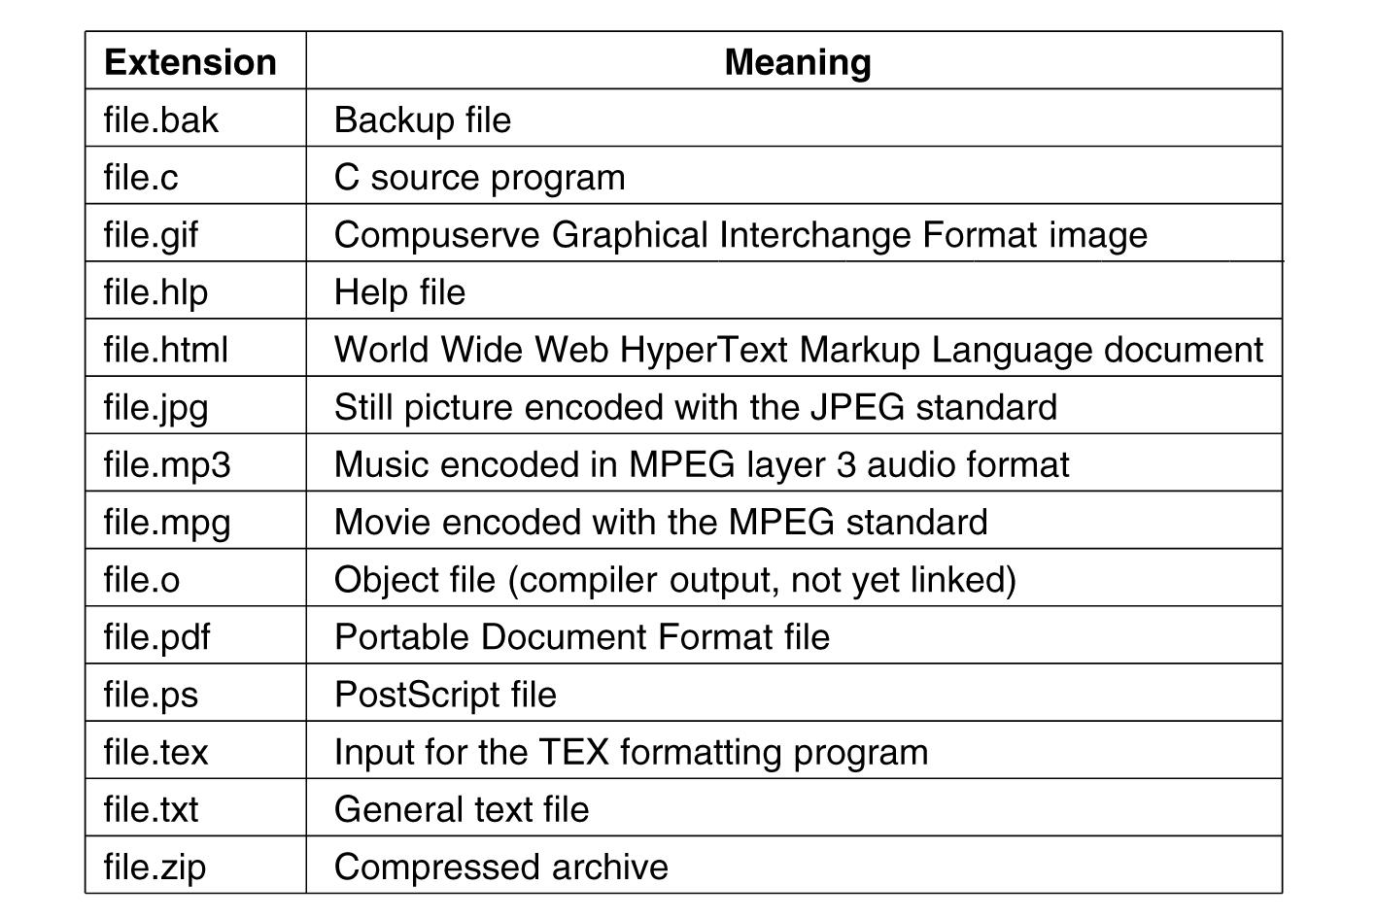
File Naming
Figure 4-1. Some typical file extensions.
Tanenbaum, Modern Operating Systems 3 e, (c) 2008 Prentice-Hall, Inc. All rights reserved. 0-13-6006639

Slide 7
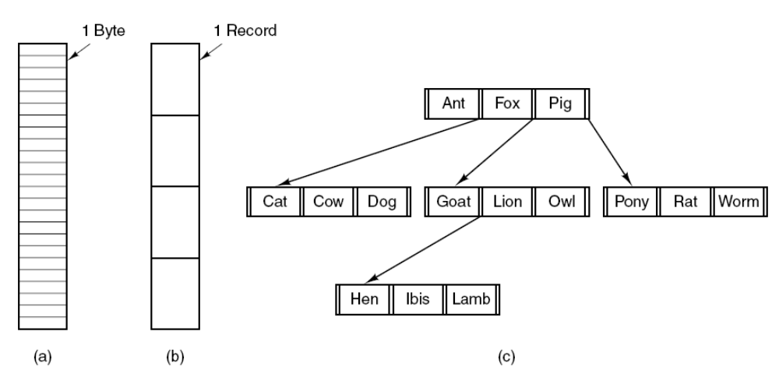
File Structure
Figure 4-2. Three kinds of files. (a) Byte sequence.
(b) Record sequence. (c) Tree.
Tanenbaum, Modern Operating Systems 3 e, (c) 2008 Prentice-Hall, Inc. All rights reserved. 0-13-6006639

Slide 8
File Types
Regular Files:
  ASCII files or binary files
  ASCII consists of lines of text; can be displayed and printed
  Binary, have some internal structure known to programs that use them
Directory
  Files to keep track of files
Character special files (a character device file)
  Related to I/O and model serial I/O devices
Block special files (a block device file)
  Mainly to model disks

Slide 9
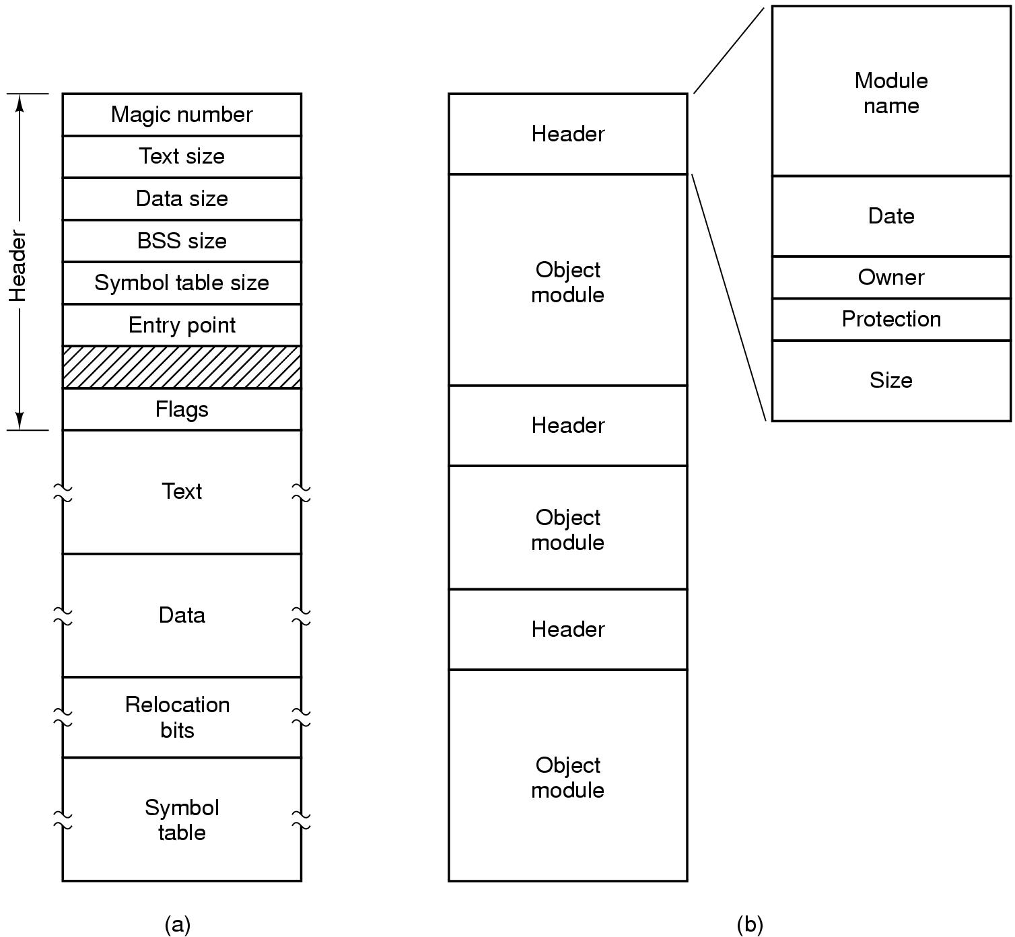
File Types
Figure 4-3. (a) An executable file. (b) An archive.
Tanenbaum, Modern Operating Systems 3 e, (c) 2008 Prentice-Hall, Inc. All rights reserved. 0-13-6006639

Slide 10
File Access
File descriptor
  A file descriptor is a small integer representing a kernel-managed object that a process may read from or write to
  Every process has a private space of file descriptors starting at 0
  By convention, 0 is standard input, 1 is standard output, and 2 is standard error
System call: read() and write() to read from and write to filles named by file descriptors

Slide 11
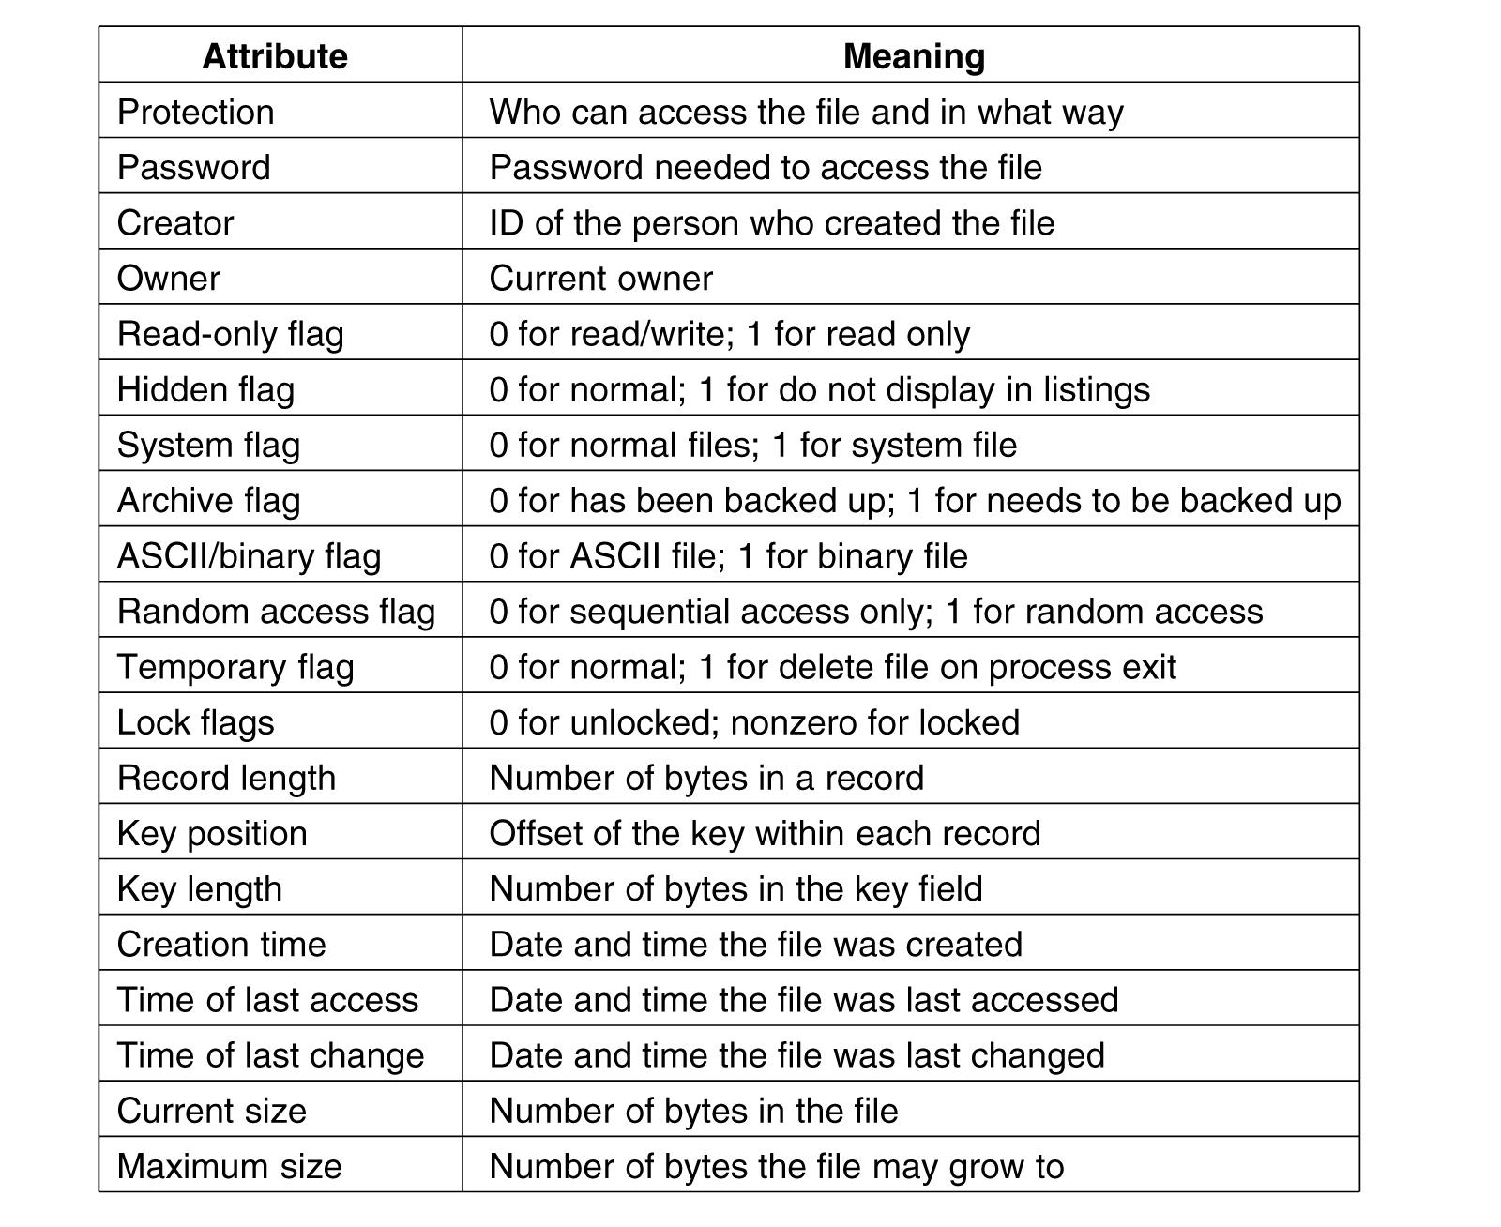
File Attributes
Figure 4-4a. Some possible file attributes.
Tanenbaum, Modern Operating Systems 3 e, (c) 2008 Prentice-Hall, Inc. All rights reserved. 0-13-6006639

Slide 12
Struct stat
Struct stat{
  mode_t st_mode; // file type and mode (permission)
  ino_t st_ino; //inode number
  dev_t st_dev; //device number
  dev_t st_rdev; //device number (special)
  nlink_t st_nlink; //number of links
  uid_t st_uid; // user ID of owner
  gid_t st_gid; // group ID of owner
  off_t st_size; //size in bytes
  time_t st_atime; //time of last access
  ……}

Slide 13
File attributes
drwxr-xr-x 2 root root 4096 Sep 24 2008 Unit2
drwxr-xr-x 2 root root 4096 May 26 19:21 a
-rwxr-xr-x 1 root root 10930 Aug 5 22:49 a.out
-rwxrwx--T 1 root root 81 Aug 2 2008 a.txt
-rwxr-x--- 1 root root 81 May 26 19:20 b.txt
-rwx------ 1 root root 81 Jul 30 19:28 c.txt
-rwxr-xr-x 1 root root 11193 Jul 30 19:27 cp

Slide 14

File Owner
Group Owner
Everyone Else
Write Permission
Read Permission
Execute
Permission

Slide 15
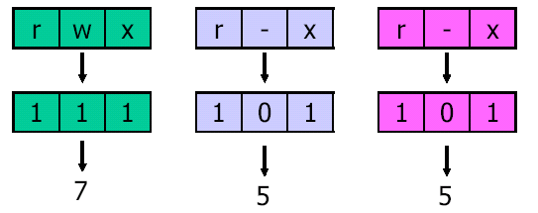
UNIX
File Owner
Group Owner
Everyone Else

Slide 16
File Operations
The most common system calls relating to files:
Create
Delete
Open
Close
Read
Write
Append
Seek
Get Attributes
Set Attributes
Rename
Tanenbaum, Modern Operating Systems 3 e, (c) 2008 Prentice-Hall, Inc. All rights reserved. 0-13-6006639

Slide 17
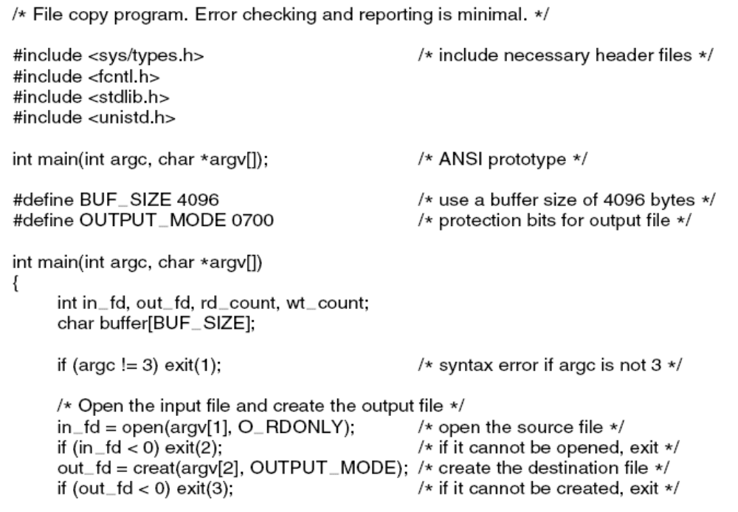
Example Program Using File System Calls (1)
. . .
Figure 4-5. A simple program to copy a file.
Tanenbaum, Modern Operating Systems 3 e, (c) 2008 Prentice-Hall, Inc. All rights reserved. 0-13-6006639

Slide 18
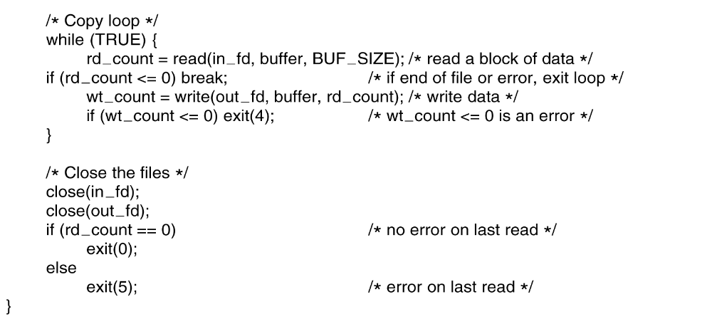
Example Program Using File System Calls (2)
Figure 4-5. A simple program to copy a file.
Tanenbaum, Modern Operating Systems 3 e, (c) 2008 Prentice-Hall, Inc. All rights reserved. 0-13-6006639

Slide 19
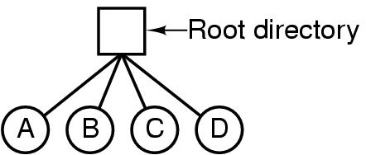
Hierarchical Directory Systems (1)
Single-level directory system:
The simpliest
Figure 4-6. A single-level directory system containing four files.
Tanenbaum, Modern Operating Systems 3 e, (c) 2008 Prentice-Hall, Inc. All rights reserved. 0-13-6006639

Slide 20
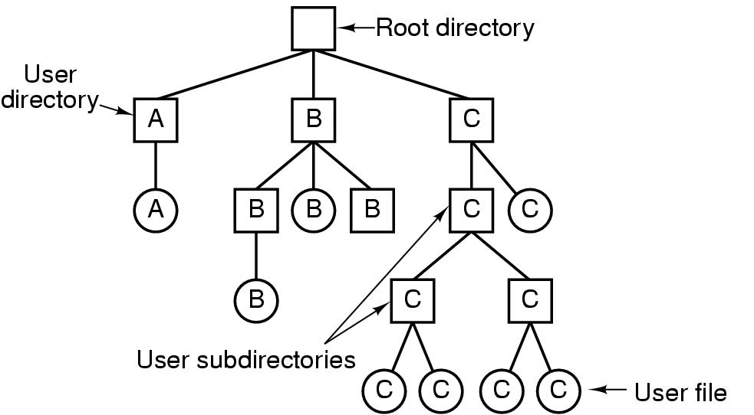
Hierarchical Directory Systems (2)
Figure 4-7. A hierarchical directory system.
Tanenbaum, Modern Operating Systems 3 e, (c) 2008 Prentice-Hall, Inc. All rights reserved. 0-13-6006639

Slide 21
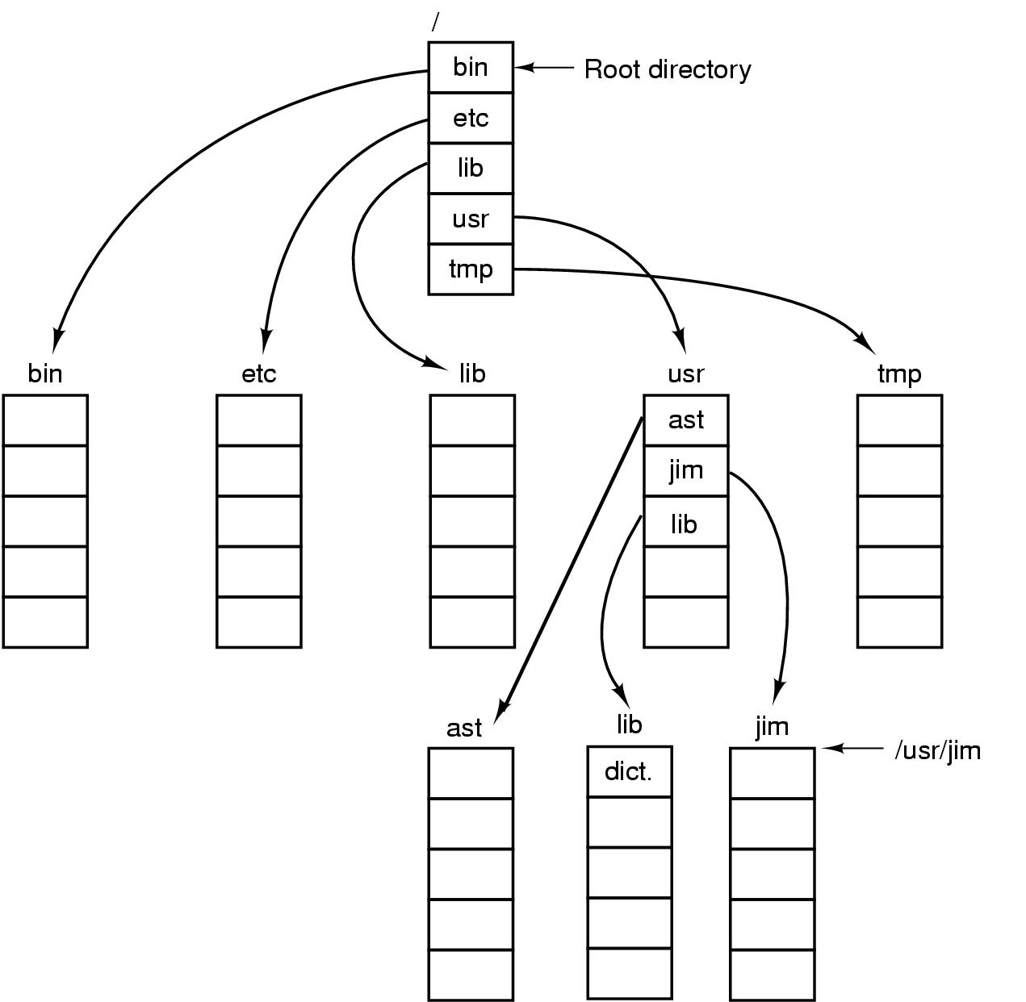
Path Names
Figure 4-8. A UNIX directory tree.
Tanenbaum, Modern Operating Systems 3 e, (c) 2008 Prentice-Hall, Inc. All rights reserved. 0-13-6006639

Slide 22
Path names
Absolute path name
  Start from root and are unique
Relative path name
  Current working set: all path names not beginning at the root directory are taken relative to the working directory
  If current working directory is /usr/ast:
    then cp /usr/ast/mailbox /usr/ast/mailbox.bak
    Is: cp mailbox mailbox.bak

Slide 23
Directory Operations
System calls for managing directories:
Create
Delete
Opendir
Closedir
Readdir
Rename
Link
Unlink
Tanenbaum, Modern Operating Systems 3 e, (c) 2008 Prentice-Hall, Inc. All rights reserved. 0-13-6006639

Slide 24
File System Implementation
Users:
  How files are names, what operations are allowed on them, what the directory tree looks like
Implementors
  How files and directories are stored, how disk space is managed and how to make every thing work efficiently and reliably

Slide 25
File System Layout
File system are stored on disks.
Most disks are divided up into several partitions
Sector 0 is called MBR (master boot record), to boot the computer
BIOS reads in and executes MBR, MBR locates the active partition, reads in the boot block, and execute
The boot block reads in the OS contained in the partition

Slide 26
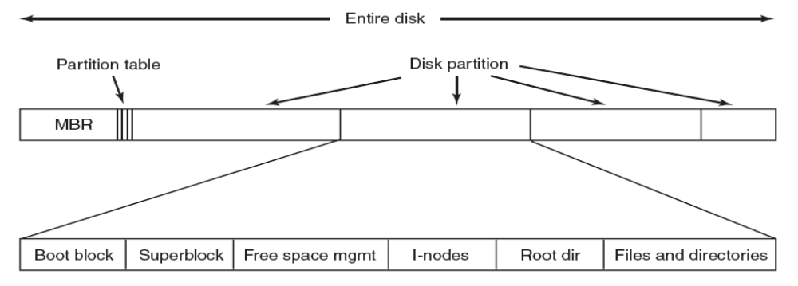
File System Layout
Superblock: contains all the key parameters about a file system; read into memory the booted or the FS is used
Figure 4-9. A possible file system layout.
Tanenbaum, Modern Operating Systems 3 e, (c) 2008 Prentice-Hall, Inc. All rights reserved. 0-13-6006639

Slide 27

Contiguous Allocation
Figure 4-10. (a) Contiguous allocation of disk space for 7 files.
(b) The state of the disk after files D and F have been removed.
Tanenbaum, Modern Operating Systems 3 e, (c) 2008 Prentice-Hall, Inc. All rights reserved. 0-13-6006639

Slide 28
Contiguous Allocation
Advantage：
  Simple to implement; to record the first block and length
  Easy to read; only one seek is needed
Disadvantage:
  Fragmentation

Slide 29

Linked List Allocation
Figure 4-11. Storing a file as a linked list of disk blocks.
Tanenbaum, Modern Operating Systems 3 e, (c) 2008 Prentice-Hall, Inc. All rights reserved. 0-13-6006639

Slide 30
Linked list allocation
To keep each file as a linked list of disk blocks
Advantage
  Only internal fragmentation
Disadvantage
  Random access is difficult
  Adding a pointer at the head of block; extra overhead while copying

Slide 31
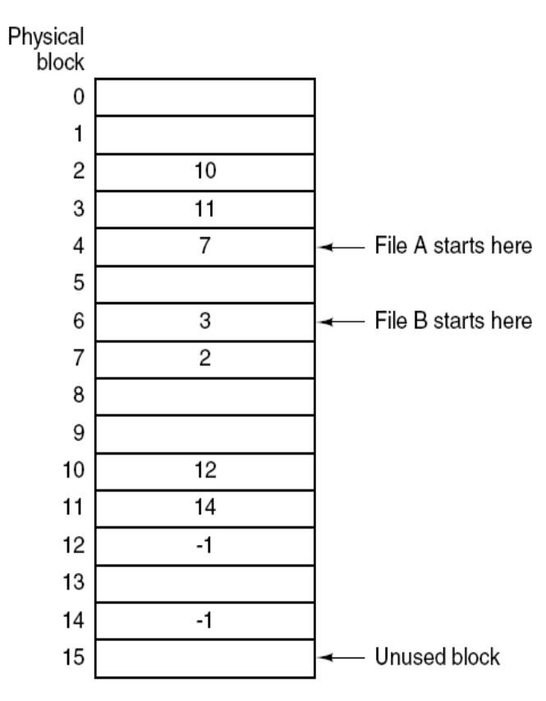
Linked List Allocation Using a Table in Memory
Figure 4-12. Linked list allocation using a file allocation table in main memory.
Tanenbaum, Modern Operating Systems 3 e, (c) 2008 Prentice-Hall, Inc. All rights reserved. 0-13-6006639

Slide 32
Linked List Allocation Using a Table in Memory
FAT-File Allocation Table
Advantage
  Can take use of the whole block
  Random access is easy
  only to store the starting block number
Disadvantage
  To keep the entire table in memory
  Can’t scale well

Slide 33
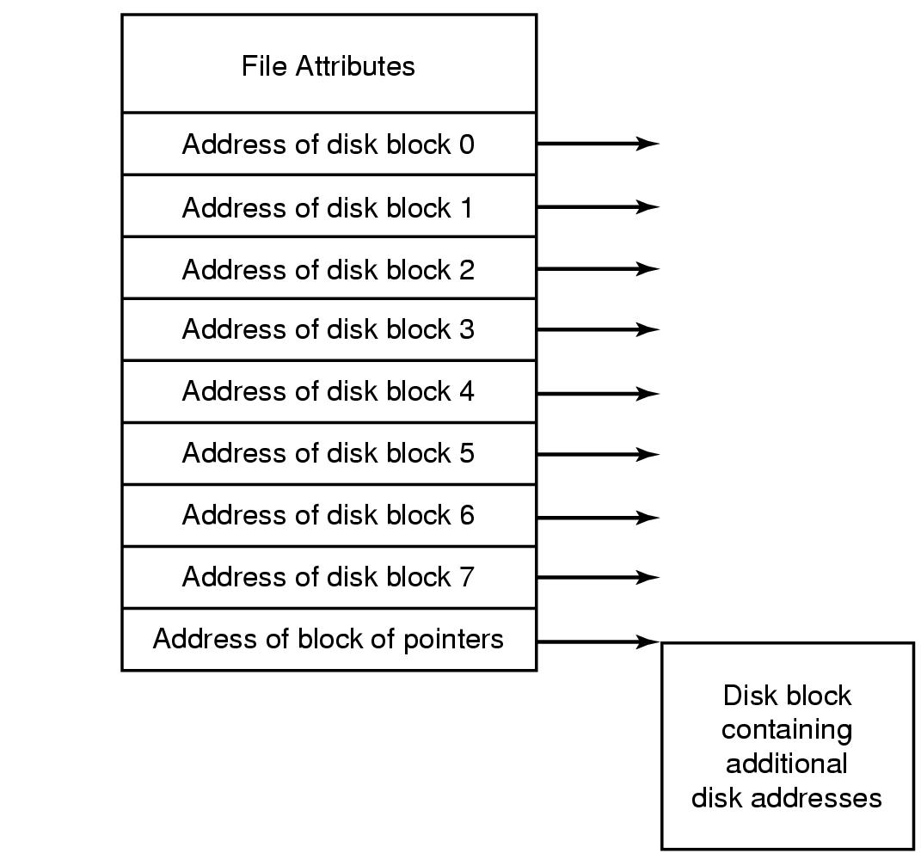
I-nodes
Figure 4-13. An example i-node.
Tanenbaum, Modern Operating Systems 3 e, (c) 2008 Prentice-Hall, Inc. All rights reserved. 0-13-6006639

Slide 34
i-nodes
Advantage
  i-node need only be in memory when the corresponding file is open; file table grows linearly with the disk
Disadvantage
  Each i-node has fixed size

Slide 35
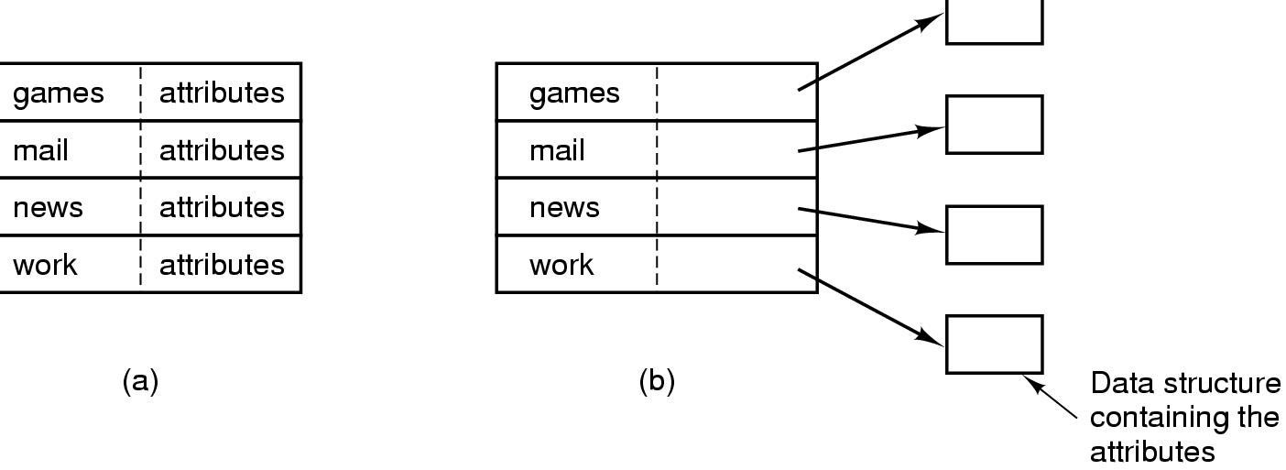
Implementing Directories (1)
Figure 4-14. (a) A simple directory containing fixed-size entries with the disk addresses and attributes in the directory entry. (b) A directory in which each entry just refers to an i-node.
Tanenbaum, Modern Operating Systems 3 e, (c) 2008 Prentice-Hall, Inc. All rights reserved. 0-13-6006639

Slide 36
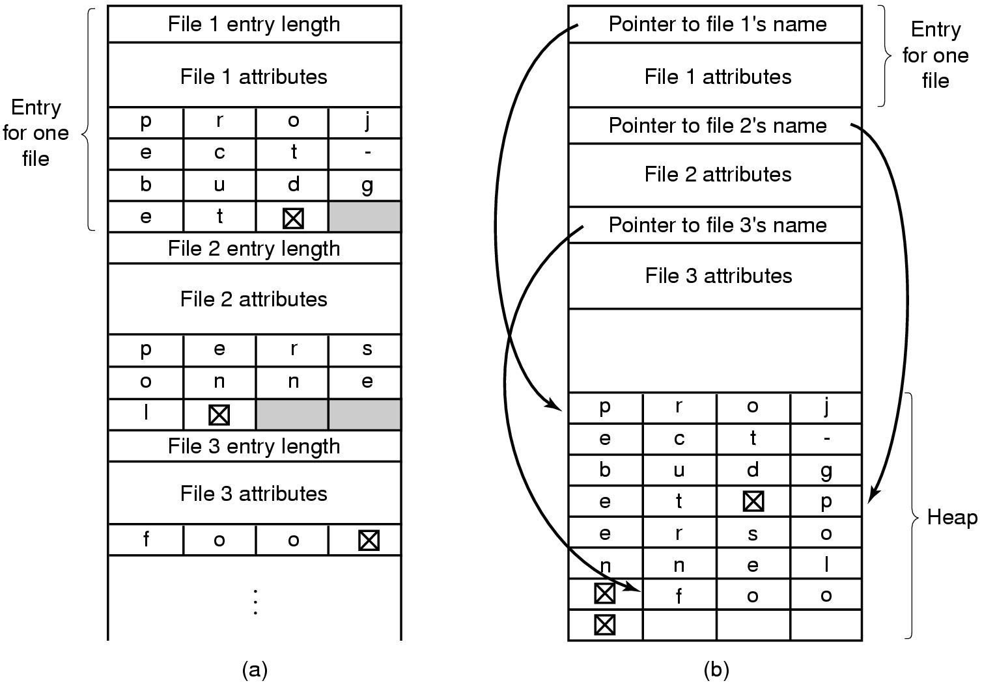
Implementing Directories (2)
Figure 4-15. Two ways of handling long file names in a directory. (a) In-line. (b) In a heap.
Tanenbaum, Modern Operating Systems 3 e, (c) 2008 Prentice-Hall, Inc. All rights reserved. 0-13-6006639

Slide 37
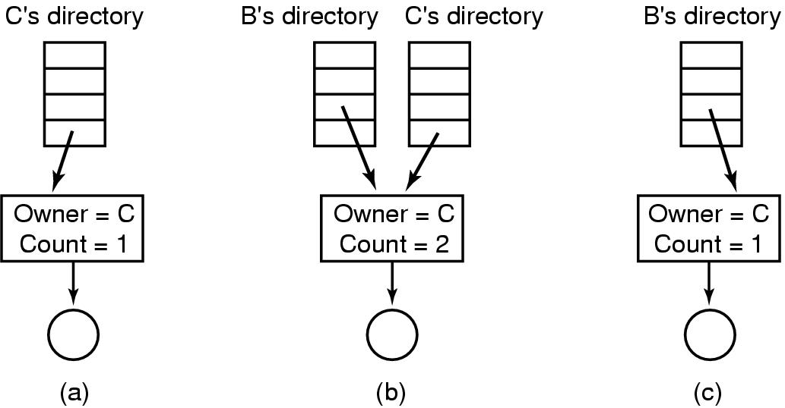
Shared Files (2)
Figure 4-17. (a) Situation prior to linking. (b) After the link is created. (c) After the original owner removes the file.
Tanenbaum, Modern Operating Systems 3 e, (c) 2008 Prentice-Hall, Inc. All rights reserved. 0-13-6006639

